Slide 1
Photonics Illuminates 6G
Chen FAN and Baiqing ZONG
March 19, 2020

Slide 2

CONTENTS
Grand Era, Grand Trend and Grand Background
Key Drivers and Use Scenarios of 6G
System Architectures and Enabling Technologies
Summary and Perspective

Slide 3
Grand Era, Grand Trend and Grand Background
Grand
Era
Era of
Electronic Information
Era of Photonic Information
Photonic Information Processing
Grand
Trend
Post-Moore Era and the End of Moore's Law
Optical Computing and Photonic AI
Moore Law
Grand
Background
Ultra-Broadband
Mobile Communication (5G)
Full-Spectral Mobile Communication (6G)
Microwave Photonics and Photonic IC

Slide 4
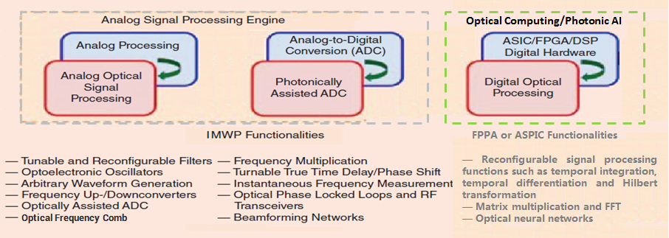
Grand Era, Grand Trend and Grand Background
In the era of photonic information, the trend of the end of Moore's Law and the background of 6G full-spectrum mobile communication, the entire signal processing chain of wireless communication is gradually migrating to the photonic domain.

Slide 5
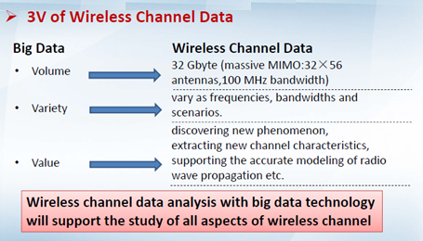
Grand Era, Grand Trend and Grand Background
The 6G hyper-scale antenna will increase the wireless channel data by hundreds or thousands of times, and thus the electrical domain processing resources will increase by hundreds or thousands of times, resulting in sever SWaP challenge.
6G ultra-large bandwidth (full-spectrum wireless communication) signal processing will consume more processing resources and more energy consumption in the electrical domain.

Slide 6
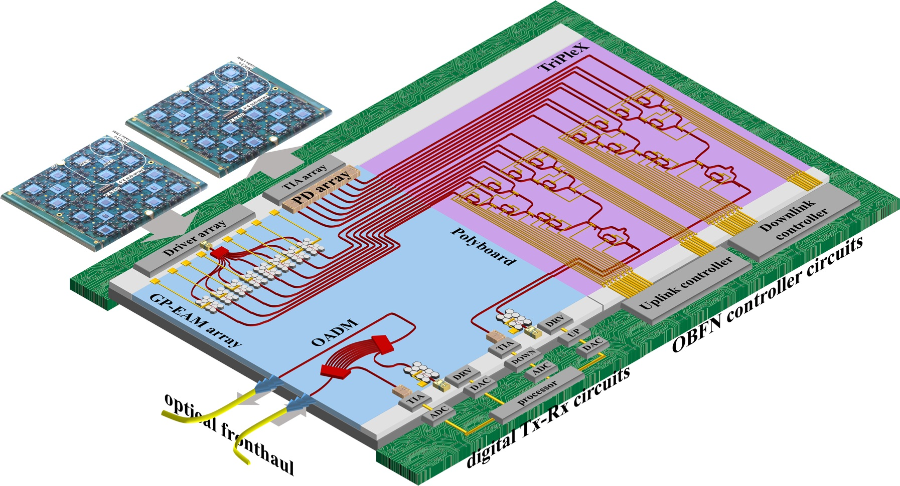
Grand Era, Grand Trend and Grand Background
The European Union is jointly developing a new all-photonic 28GHz millimeter wave mMIMO transceiver, and launched the first version at the end of 2018. Companies and research institutes participating in the R & D program include LioniX, Solmates, SATRAX, Linkra, Fraunhofer HHI and NTU's ICCS. The chip uses a heterogeneous integration process, through the heterogeneous integration of PolyBoard and TriPleX platforms, combining the advantages of the two platforms, to provide personalized solutions for future wireless communication needs.

Slide 7
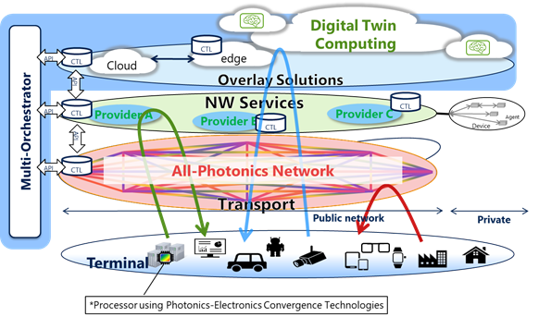
Grand Era, Grand Trend and Grand Background
In October 2019, NTT, Intel and SONY jointly launched a global forum on innovative optical and wireless network (IOWN) for 6G. The organization will develop technologies, frameworks, specifications and reference designs for an all-photonic infrastructure for future communications, including photonic processors, photonic network equipment, and end-to-end architectures that take advantage of advanced optoelectronic converged technologies. The goal is to increase the network's energy consumption, latency and transmission performance by a factor of 100 in the future.

Slide 8
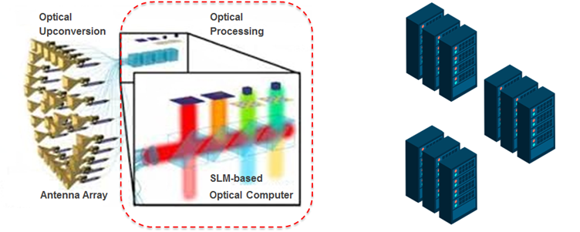
Grand Era, Grand Trend and Grand Background
Next generation wireless platform based on microwave photonic antenna front-end and SLM optical computing

Slide 9
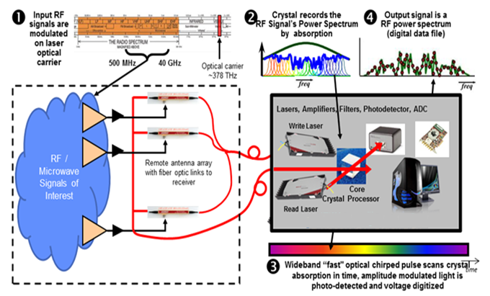
Grand Era, Grand Trend and Grand Background
RF spectrum deep learning, identification and analysis;
RF spectrum big data mining (Spectra Mining);
Dynamic spectrum mapping (RF Mapping) and dynamic spectrum allocation;
Flexible high-precision real-time positioning and adaptive precise target recognition;
Extreme broadband all-photon platform (bandwidth up to 40GHz)
All Photonic Engine
Next generation wireless platform based on microwave photonic distributed antenna and SHB optical computing

Slide 10
Grand Era, Grand Trend and Grand Background
Osaka University of Japan has realized the integration of patch antennas on optical modulators, and the University of Delaware has successfully prepared a UTC-PD coupled antenna array and established related design models.

Slide 11
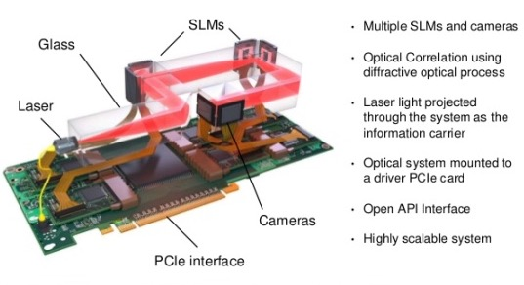
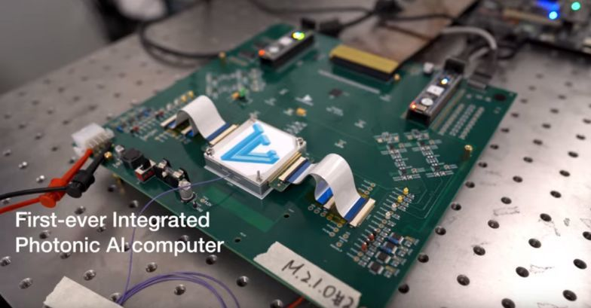
Grand Era, Grand Trend and Grand Background
Optalysys released the first generation of high-performance desktop super photonic computers (up to 9Pfps processing speed) in 2017. Its photonic processor uses a PCI expansion card to communicate with ordinary computers. Optalysys plans to launch a higher-performance super-optical computing system at the Efps level by 2020.
Lightelligence launched photonic computing chip products in the first quarter of 2019. Lightmatter is also using photonic technology to bolster the performance of electronic computers, and fundamentally introduce new powerful computing chips to promote the development of next-generation artificial intelligence.

Slide 12
CONTENTS
Grand Era, Grand Trend and Grand Background
Key Drivers and Use Scenarios of 6G
System Architectures and Enabling Technologies
Summary and Perspective

Slide 13
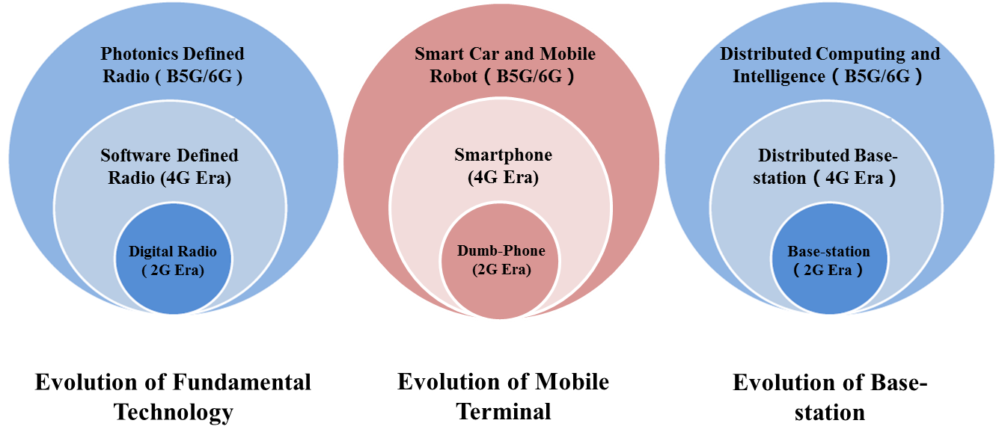
Key Drivers and Use Scenarios of 6G
Possible evolution paths of terminal type, fundamental enabling technology and network architecture of 6G.

Slide 14
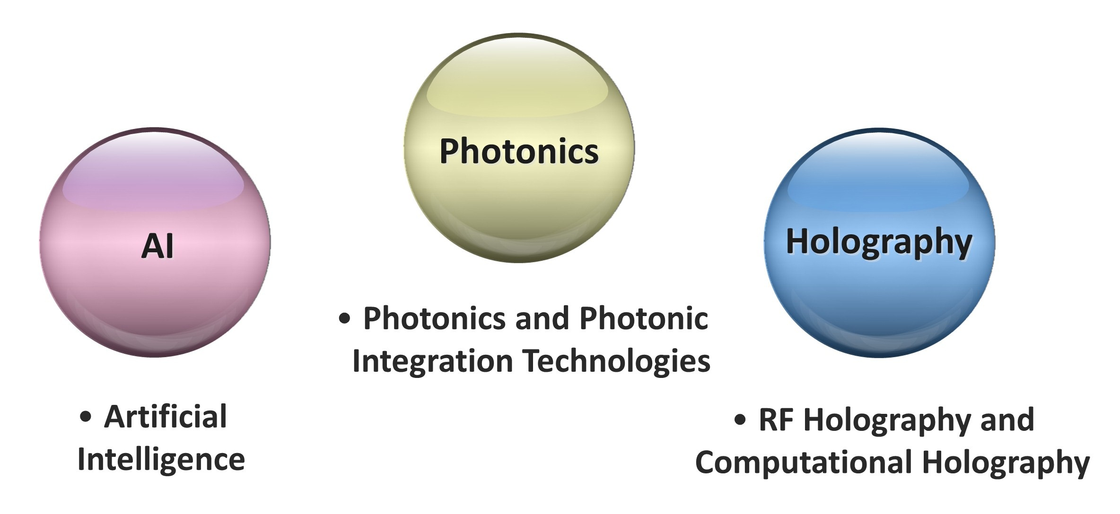
Key Drivers and Use Scenarios of 6G
Several key enabling technologies of 6G

Slide 15
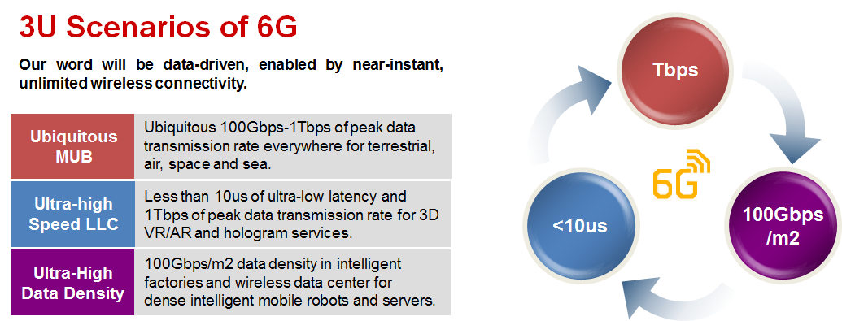
Key Drivers and Use Scenarios of 6G

Slide 16
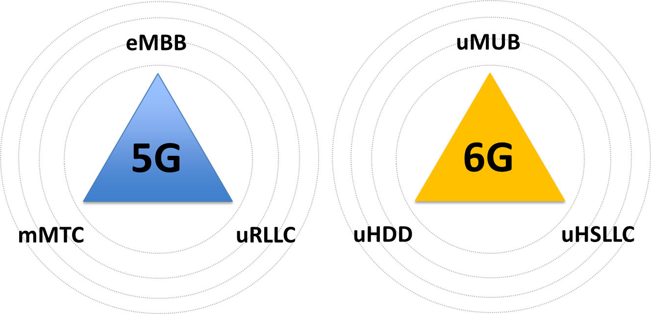
Key Drivers and Use Scenarios of 6G
Comparisons of key requirements of 5G and 6G

Slide 17
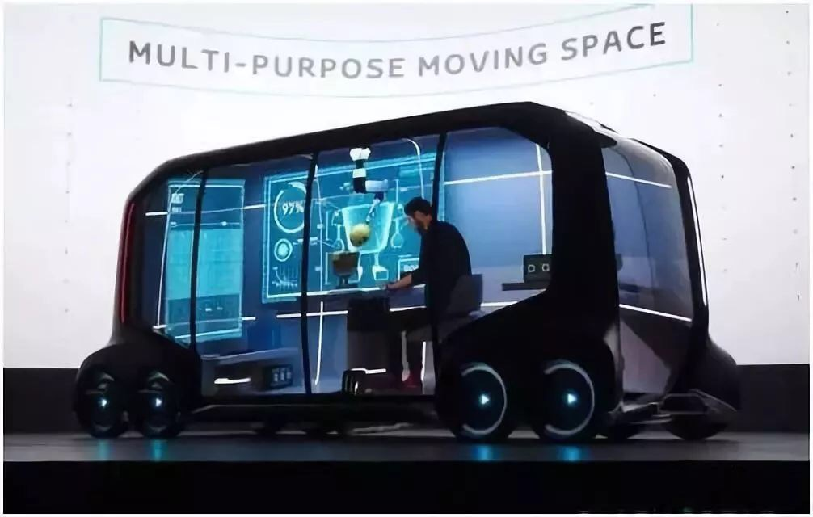
Key Drivers and Use Scenarios of 6G
8K/4K、ＶＲ and 3D Video
3D Real-time Maps
6G
MaaS（Mobile as a Service）
Smart Car and UAV as a moving space for living and working
uMUB use scenario

Slide 18
Key Drivers and Use Scenarios of 6G
Intelligent Factory
uHDD use scenario
uBBLLC use scenario
Intelligent mobile robots

Slide 19
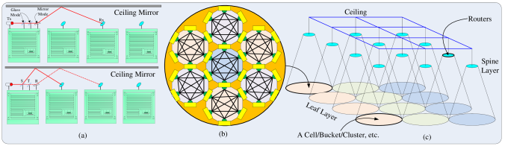
Key Drivers and Use Scenarios of 6G
100Gbps/m2 uHDD use scenario of WDCN

Slide 20
CONTENTS
Grand Era, Grand Trend and Grand Background
Key Drivers and Use Scenarios of 6G
System Architectures and Enabling Technologies
Summary and Perspective

Slide 21
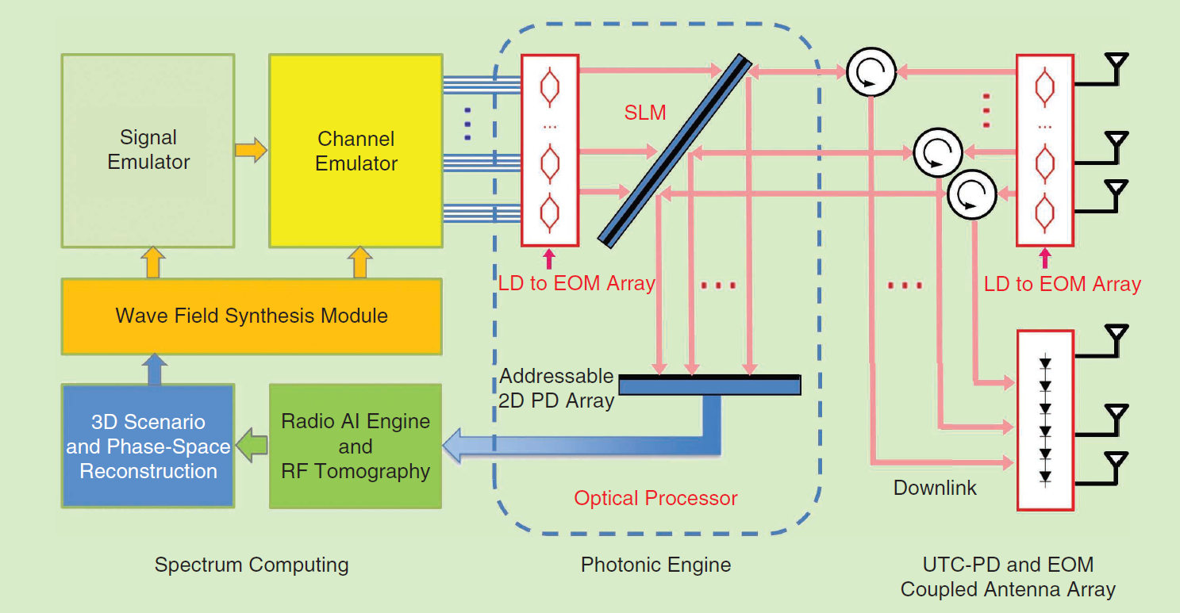
System Architectures and Enabling Technologies
Holographic Radio
The implementation and system architecture of all-photonic RANs for computational holographic radio

Slide 22
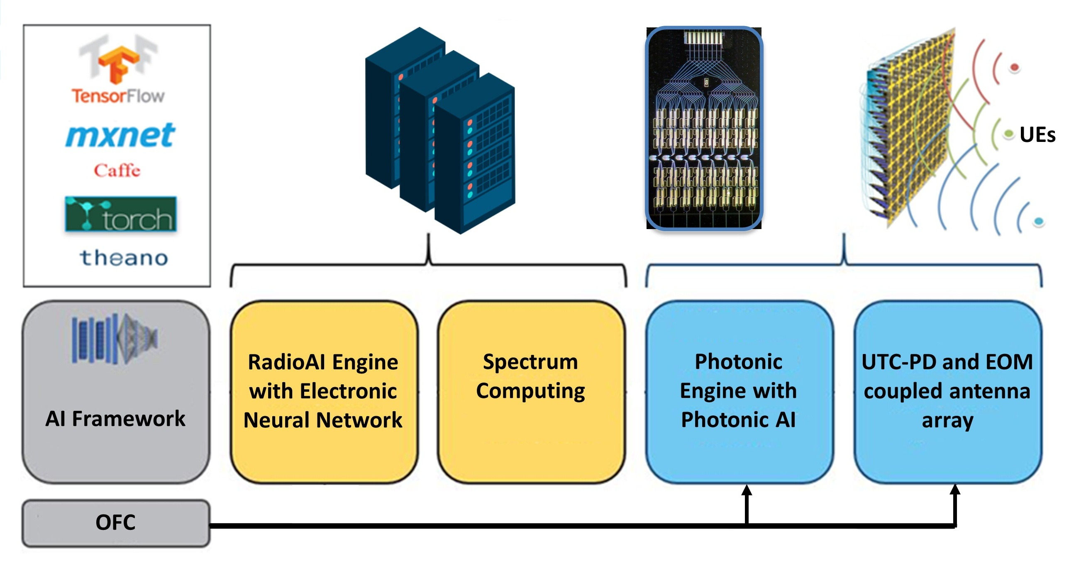
System Architectures and Enabling Technologies
AI and Photonics-Based Cognitive Radio
The general framework of the photonics-based cognitive radio system. OFC: optical frequency comb.

Slide 23
System Architectures and Enabling Technologies
Multipurpose Converged, Full-Spectral, and All-Photonic RANs
The full-spectral or hyperspectral converged AAU of sensing, imaging, and communication
in 6G. DEMUX: demultiplexer; MUX: multiplexer; SOA: semiconductor optical amplifier.

Slide 24
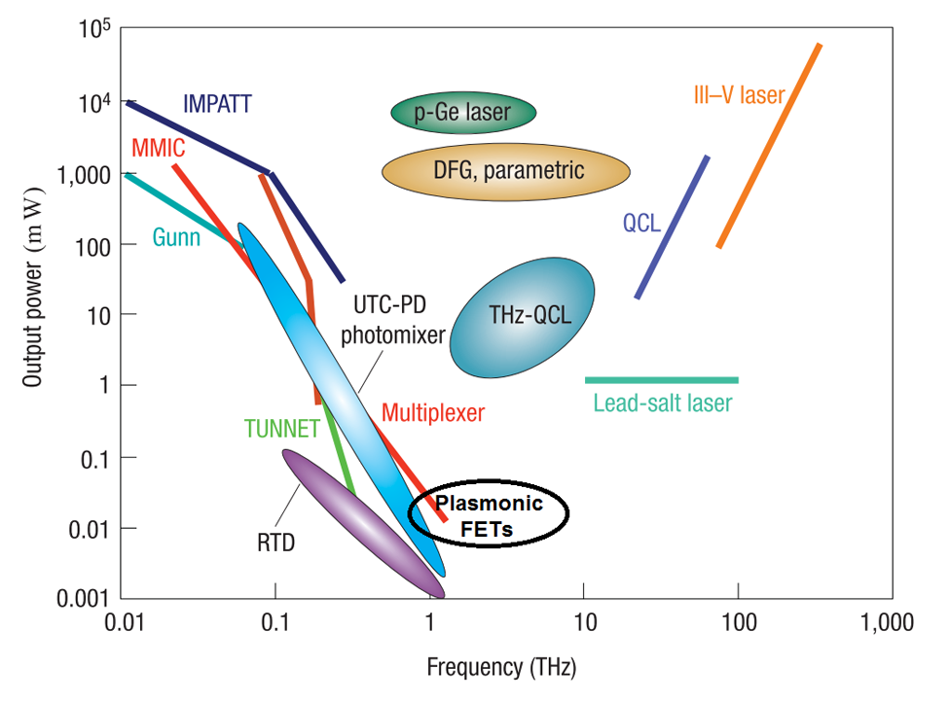
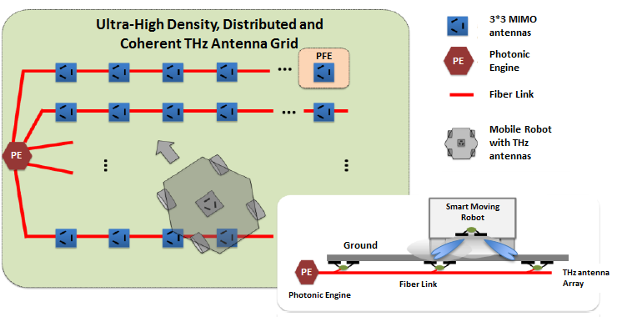
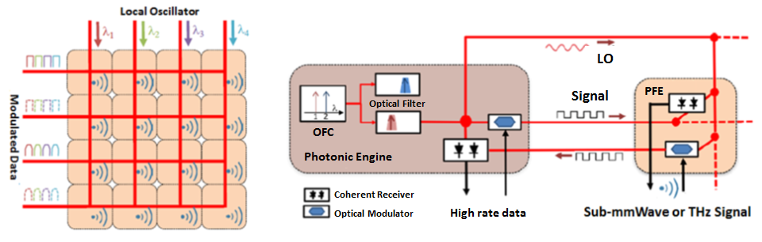
System Architectures and Enabling Technologies
THz near-field mobile network based on LatticeRAN
Ultra high density THz optical coherent distributed antenna lattice in smart factory and wireless data center environment
Notes:
开放性问题：用于THz频段的电光调制器和光混频器。比较有前途的是基于等离子激元的电光调制器和基于石墨烯的UTC-PD光混频器。

Slide 25
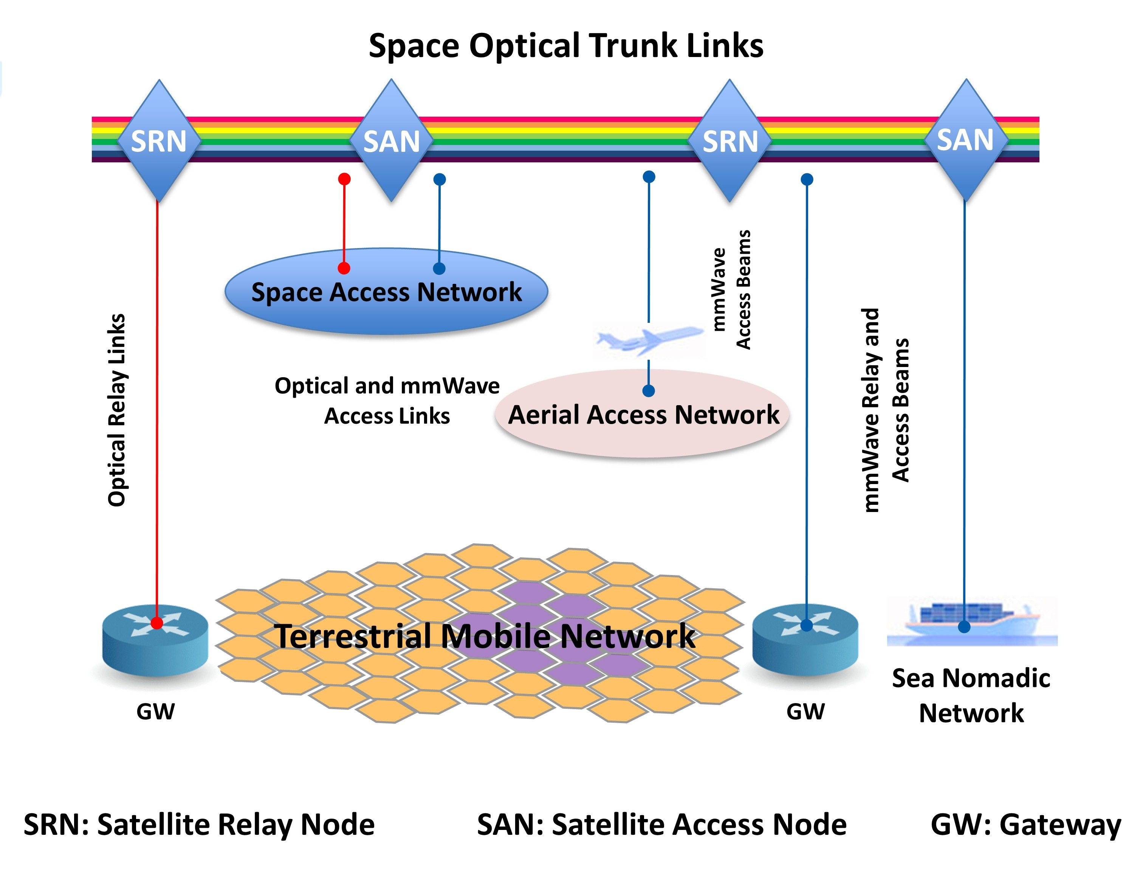
System Architectures and Enabling Technologies
Hyperspectral Space–Terrestrial Integration Network
Multi photon satellite payloads with cost, volume, weight and power advantages; ；
Dynamic networking with low delay and high reliability ；
Millimeter wave and coherent laser communication aggregation ；
Hybrid laser / THz / millimeter wave fusion transceiver technology, including servo tracking system ；
Adaptive optics technology to compensate wavefront distortion caused by atmospheric turbulence ；
Laser, THz and millimeter wave aggregation and diversity technology.
The hyperspectral aerial–space–terrestrial integrated network architecture of 6G, based on laser–mm-wave convergence.

Slide 26
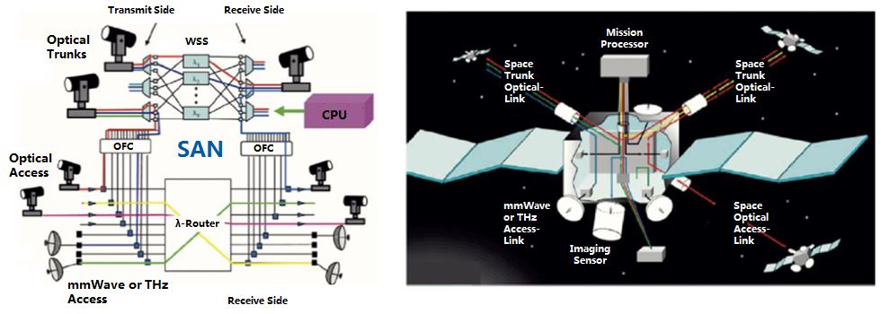
System Architectures and Enabling Technologies
All Photonic and Full-Spectral Payload

Slide 27
CONTENTS
Grand Era, Grand Trend and Grand Background
Key Drivers and Use Scenarios of 6G
System Architectures and Enabling Technologies
Summary and Perspective

Slide 28
Summary and Perspective
The key drivers of 6G mainly result from the technology-driven paradigm shift. As a new paradigm, photonics is bound to stand out as a breakthroughs and disruptive technology for 6G.
Meanwhile, intelligent driving and smart industry revolutions create core requirements for 6G that will lead to service classes of uMUB, uHSLLC/uBBLLC, and uHDD.
Matching these services requires an end-to-end co-design of communication, sensing, as well as computing, and inspires the convergence of photonics and AI, resulting in two candidates for 6G-enabling technologies: photonics-based cognitive radio and holographic radio.
In particular, since many investigations have described the performances of all-optical networks with low latency, the multi-purpose, full-spectral, and all-photonic RANs may play an important role in uHSLLC/uBBLLC case scenario.
In uMUB service, the space-terrestrial integrated network uses a new architecture, namely a 100Gbps hyperspectral space-terrestrial integrated network based on laser-millimeter wave-THz convergence, of which the key technologies include all-photonic satellite payloads.

Slide 29

Thank you
Photonics Illuminates 6G

